Slide 1
PL/SQL
Basics, Procedures and Functions

Slide 2
Introduction
A subprogram is a program unit/module that performs a particular task
A subprogram can be invoked by another subprogram or program which is called the calling program.
A subprogram can be created:
  At schema level
  Inside a package
  Inside a PL/SQL block

Slide 3
Schema Level
A schema level subprogram is a standalone subprogram. It is created with the CREATE PROCEDURE or CREATE FUNCTION statement. It is stored in the database and can be deleted with the DROP PROCEDURE or DROP FUNCTION statement.

Slide 4
Package Level
A subprogram created inside a package is a packaged subprogram. It is stored in the database and can be deleted only when the package is deleted with the DROP PACKAGE statement.

Slide 5
PL/SQL
PL/SQL subprograms are named PL/SQL blocks that can be invoked with a set of parameters. PL/SQL provides two kinds of subprograms:
Functions: these subprograms return a single value, mainly used to compute and return a value.
Procedures: these subprograms do not return a value directly, mainly used to perform an action.

Slide 6
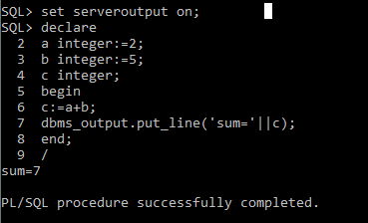
Simple Add – Addition of 2 Numbers
declare
a integer:=2;
b integer:=5;
c integer;
begin
c:=a+b;
dbms_output.put_line(‘sum=‘||c);
end;
/

Slide 7
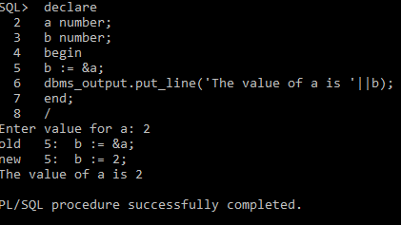
Getting input from user
declare
a number;
b number;
begin
b := &a;
dbms_output.put_line('The value of a is '||b);
end;
/

Slide 8
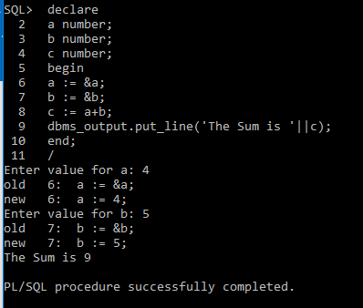
add
declare
a number;
b number;
c number;
begin
a := &a;
b := &b;
c := a+b;
dbms_output.put_line('The Sum is '||c);
end;
/

Slide 9
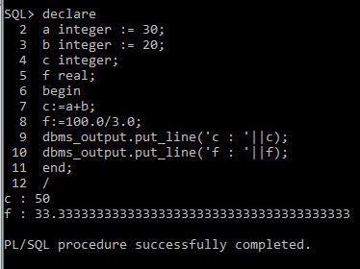
PL/SQL Variables – Print an integer and float values
declare
a integer := 30;
b integer := 20;
c integer;
f real;
begin
c:=a+b;
f:=100.0/3.0;
dbms_output.put_line('c : '||c);
dbms_output.put_line('f : '||f);
end;
/

Slide 10
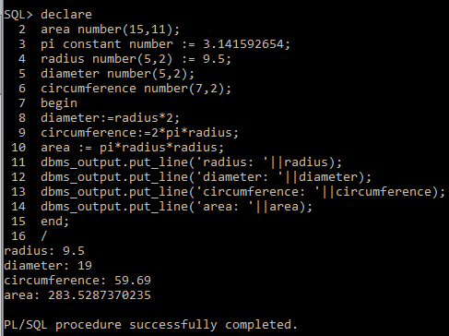
PL/SQL – Constants – Find diameter, circumference, area
declare
area number(15,11);
pi constant number := 3.141592654;
radius number(5,2) := 9.5;
diameter number(5,2);
circumference number(7,2);
begin
diameter:=radius*2;
circumference:=2*pi*radius;
area := pi*radius*radius;
dbms_output.put_line('radius: '||radius);
dbms_output.put_line('diameter: '||diameter);
dbms_output.put_line('circumference: '||circumference);
dbms_output.put_line('area: '||area);
end;
/

Slide 11
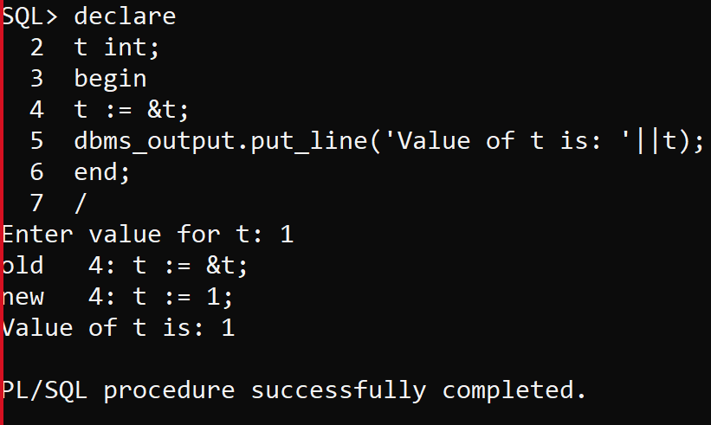
Input from the user
declare
t int;
begin
t := &t;
dbms_output.put_line('Value of t is: '||t);
end;
/

Slide 12
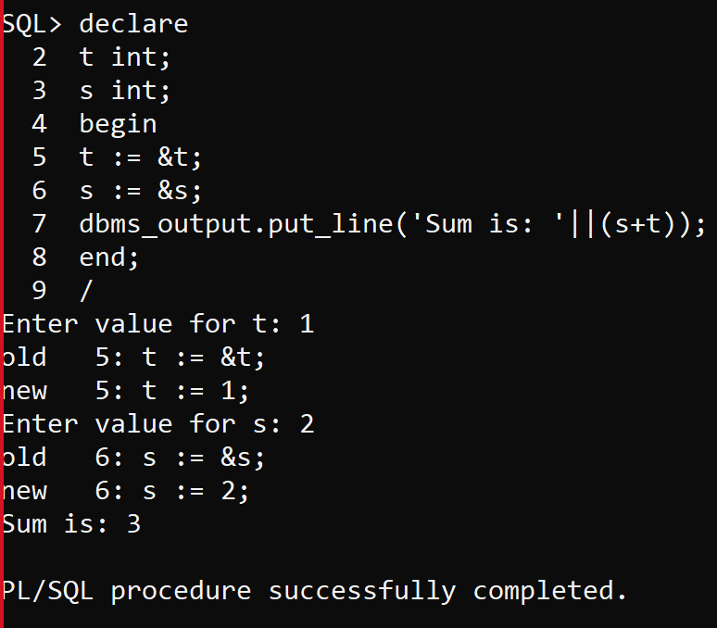
declare
t int;
s int;
begin
t := &t;
s := &s;
dbms_output.put_line('Sum is: '||(s+t));
end;
/

Slide 13
PL/SQL Basics – If Structure
IF condition1
THEN
{...statements to execute when condition1 is TRUE...}
ELSIF condition2
THEN
{...statements to execute when condition2 is TRUE...}
ELSE
{...statements to execute when both condition1 and condition2 are FALSE...}
END IF;

Slide 14
PL/SQL Basics – If – Example –
Given number is Greater or lesser
declare
a number(3) := 500;
begin
-- check the boolean condition using if statement
if( a < 20 ) then
-- if condition is true then print the following
dbms_output.put_line('a is less than 20 ' );
else
dbms_output.put_line('a is not less than 20 ' );
end if;
dbms_output.put_line('value of a is : ' || a);
end;
/

Slide 15
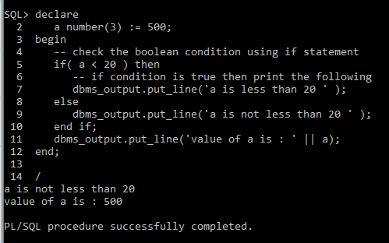
PL/SQL Basics – If – Example –
Given number is Greater or lesser

Slide 16
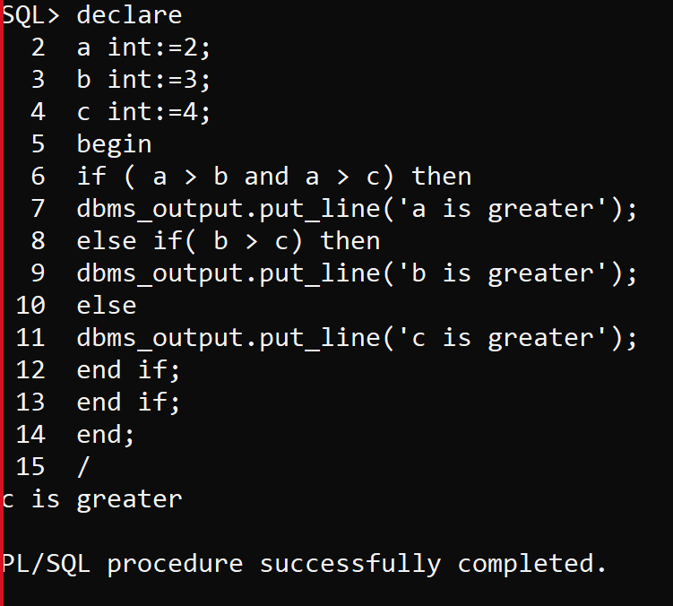
Greatest of 3 numbers
declare
a int:=2;
b int:=3;
c int:=4;
begin
if ( a > b and a > c) then
dbms_output.put_line('a is greater');
else if( b > c) then
dbms_output.put_line('b is greater');
else
dbms_output.put_line('c is greater');
end if;
end if;
end;
/

Slide 17
PL/SQL Basics – Case Structure
CASE [ expression ]
WHEN condition_1 THEN result_1
WHEN condition_2 THEN result_2
...
WHEN condition_n THEN result_n
ELSE result
END

Slide 18
PL/SQL Basics – Case - Example
declare
grade char(1) := 'a';
begin
case grade
when 'a' then dbms_output.put_line('excellent');
when 'b' then dbms_output.put_line('very good');
when 'c' then dbms_output.put_line('good');
when 'd' then dbms_output.put_line('average');
when 'f' then dbms_output.put_line('passed with grace');
else dbms_output.put_line('failed');
end case;
end;
/

Slide 19
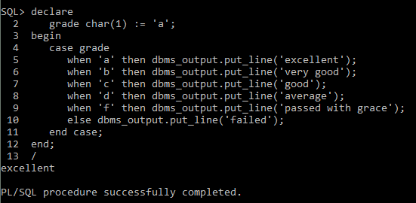
PL/SQL Basics – Case - Output

Slide 20
PL/SQL Basics – Loop - Structure
LOOP
Sequence of statements;
END LOOP;
Types:
There are 4 types of PL/SQL Loops.
Basic Loop / Exit Loop
While Loop
For Loop
Cursor For Loop

Slide 21
PL/SQL Basics – Basic Loop - Structure
LOOP statements;
EXIT;
{
or EXIT WHEN condition;
}
END LOOP

Slide 22
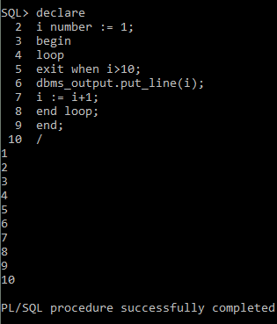
PL/SQL Basics – Basic Loop – Example – Print 1 to 10
declare
i number := 1;
begin
loop
exit when i>=10;
dbms_output.put_line(i);
i := i+1;
end loop;
end;
/

Slide 23
PL/SQL Basics – While Loop - Structure
WHILE <condition>
LOOP statements;
END LOOP;

Slide 24
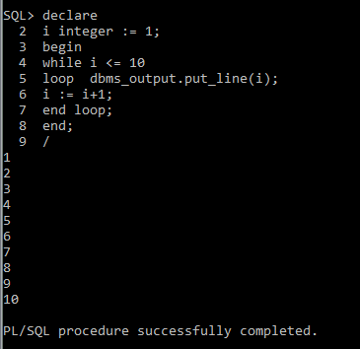
PL/SQL Basics – While Loop - Example
declare
i integer := 1;
begin
while i <= 10
loop dbms_output.put_line(i);
i := i+1;
end loop;
end;
/

Slide 25
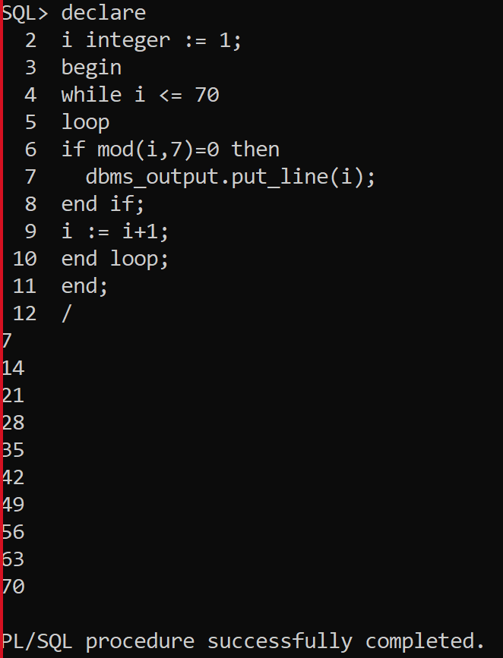
Multiples of 7
declare
i integer := 1;
begin
while i <= 70
loop
if mod(i,7)=0 then
dbms_output.put_line(i);
end if;
i := i+1;
end loop;
end;
/

Slide 26
PL/SQL Basics – For Loop - Structure
FOR counter IN initial_value .. final_value LOOP
LOOP statements;
END LOOP;

Slide 27
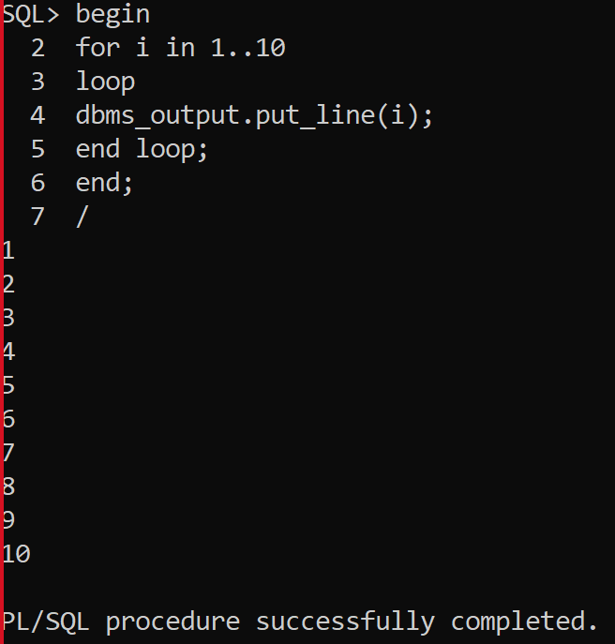
PL/SQL Basics – For Loop – Example –
Print 1 to 10
begin
for i in 1..10
loop
dbms_output.put_line(i);
end loop;
end;

Slide 28
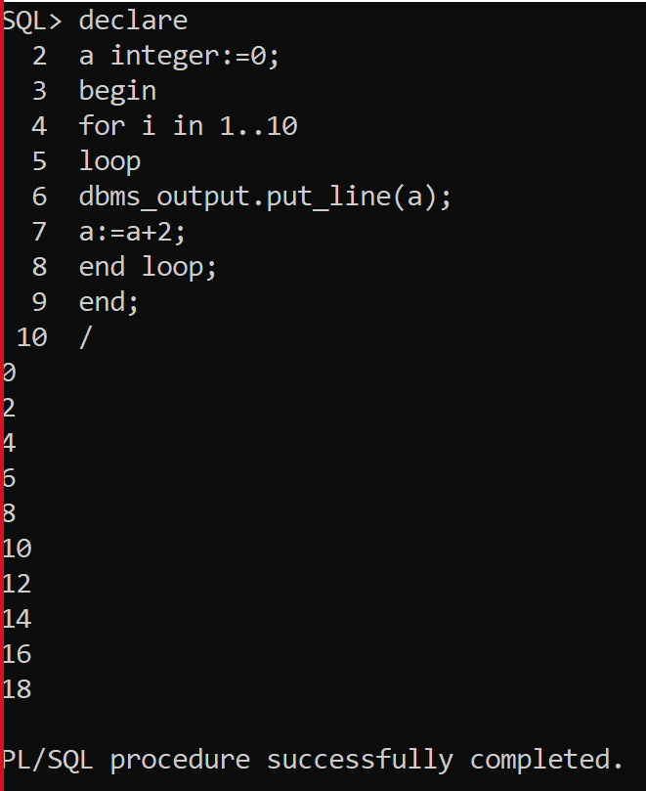
Incrementing the for loop >2
declare
a integer:=0;
begin
for i in 1..10
loop
dbms_output.put_line(a);
a:=a+2;
end loop;
end;

Slide 29
PL/SQL Basics – Continue
Syntax:
continue;
If a continue statement exits a cursor FOR LOOP prematurely then it exits an inner loop and transfer control to the next iteration of an outer loop, the cursor closes (in this context, CONTINUE works like GOTO).

Slide 30
PL/SQL Basics – Continue – Example
declare
x number := 0;
begin
loop -- after continue statement, control resumes here
dbms_output.put_line ('inside loop: x = ' || to_char(x));
x := x + 1;
if x < 3 then
continue;
end if;
dbms_output.put_line
('inside loop, after continue: x = ' || to_char(x));
exit when x = 5;
end loop;
dbms_output.put_line (' after loop: x = ' || to_char(x));
end;
/

Slide 31
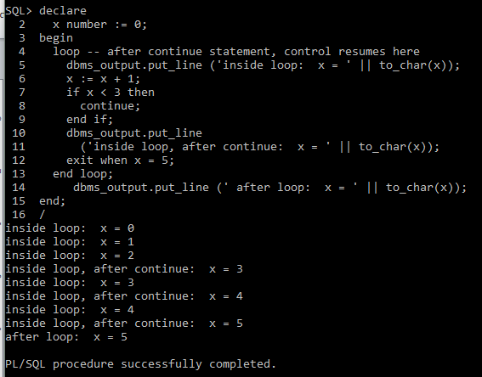
PL/SQL Basics – Continue – Output

Slide 32
Parts of a PL/SQL Subprogram
S.N. | Parts & Description
1 | Declarative Part It is an optional part. However, the declarative part for a subprogram does not start with the DECLARE keyword. It contains declarations of types, cursors, constants, variables, exceptions, and nested subprograms. These items are local to the subprogram and cease to exist when the subprogram completes execution.
2 | Executable Part This is a mandatory part and contains statements that perform the designated action.
3 | Exception-handling This is again an optional part. It contains the code that handles run-time errors.

Slide 33
Creating a Procedure
A procedure is created with the CREATE OR REPLACE PROCEDURE statement. The simplified syntax for the CREATE OR REPLACE PROCEDURE statement is as follows:
CREATE [OR REPLACE] PROCEDURE procedure_name [(parameter_name [IN | OUT | IN OUT] type [, ...])] {IS | AS} BEGIN < procedure_body > END procedure_name;

Slide 34
Creating a Procedure
procedure-name specifies the name of the procedure.
[OR REPLACE] option allows modifying an existing procedure.
The optional parameter list contains name, mode and types of the parameters. IN represents that value will be passed from outside and OUT represents that this parameter will be used to return a value outside of the procedure.
procedure-body contains the executable part.
The AS keyword is used instead of the IS keyword for creating a standalone procedure.

Slide 35
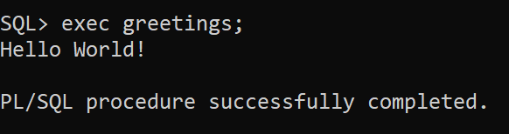
Executing a Standalone Procedure
A standalone procedure can be called in two ways:
Using the EXECUTE keyword
Calling the name of the procedure from a PL/SQL block
The above procedure named 'greetings' can be called with the EXECUTE keyword as:
EXECUTE greetings;
exec greetings;

Slide 36
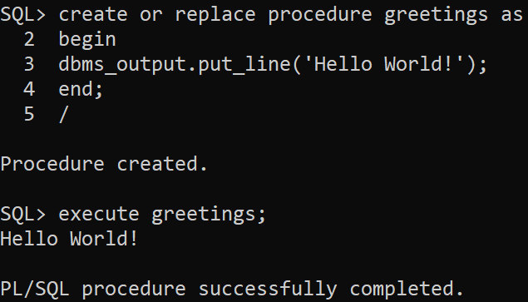
Creating a Procedure
Example:
create or replace procedure greetings as
begin
dbms_output.put_line('Hello World!');
End;
/

Slide 37
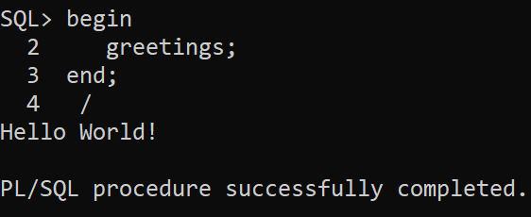
Executing a Standalone Procedure
The procedure can also be called from another PL/SQL block:
begin
greetings;
end;
/

Slide 38
Deleting a Standalone Procedure
A standalone procedure is deleted with the DROP PROCEDURE statement. Syntax for deleting a procedure is:
DROP PROCEDURE procedure-name;

Slide 39
Parameter Modes in PL/SQL – Procedures represented as functions
S.N. | Parameter Mode & Description
1 | IN An IN parameter lets you pass a value to the subprogram. It is a read-only parameter. Inside the subprogram, an IN parameter acts like a constant. It cannot be assigned a value. You can pass a constant, literal, initialized variable, or expression as an IN parameter. You can also initialize it to a default value; however, in that case, it is omitted from the subprogram call. It is the default mode of parameter passing. Parameters are passed by reference.
2 | OUT An OUT parameter returns a value to the calling program. Inside the subprogram, an OUT parameter acts like a variable. You can change its value and reference the value after assigning it. The actual parameter must be variable and it is passed by value.
2 | IN OUT An IN OUT parameter passes an initial value to a subprogram and returns an updated value to the caller. It can be assigned a value and its value can be read. The actual parameter corresponding to an IN OUT formal parameter must be a variable, not a constant or an expression. Formal parameter must be assigned a value. Actual parameter is passed by value.

Slide 40
IN & OUT Mode Example 1
declare
a number;
b number;
c number;
procedure findmin(x in number, y in number, z out number) is
begin
if x < y then
z:= x;
else
z:= y;
end if;
end;

Slide 41
IN & OUT Mode Example 1
begin
a:= 23;
b:= 45;
findmin(a, b, c);
dbms_output.put_line(' minimum of (23, 45) : ' || c);
end;
/
O/P
Minimum of (23, 45) : 23
PL/SQL procedure successfully completed.

Slide 42
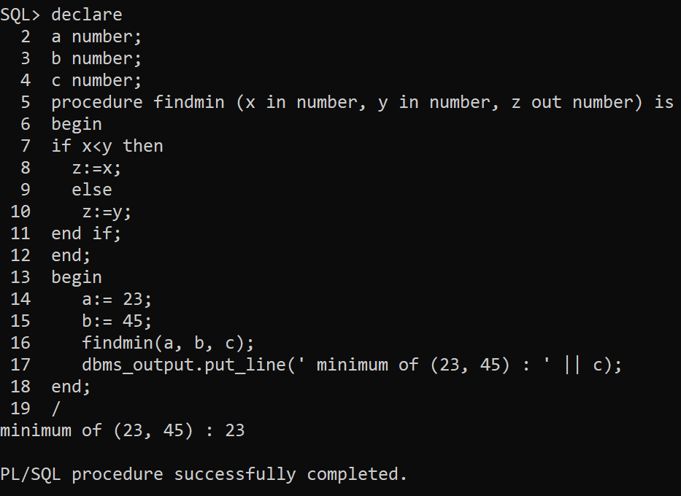

Slide 43
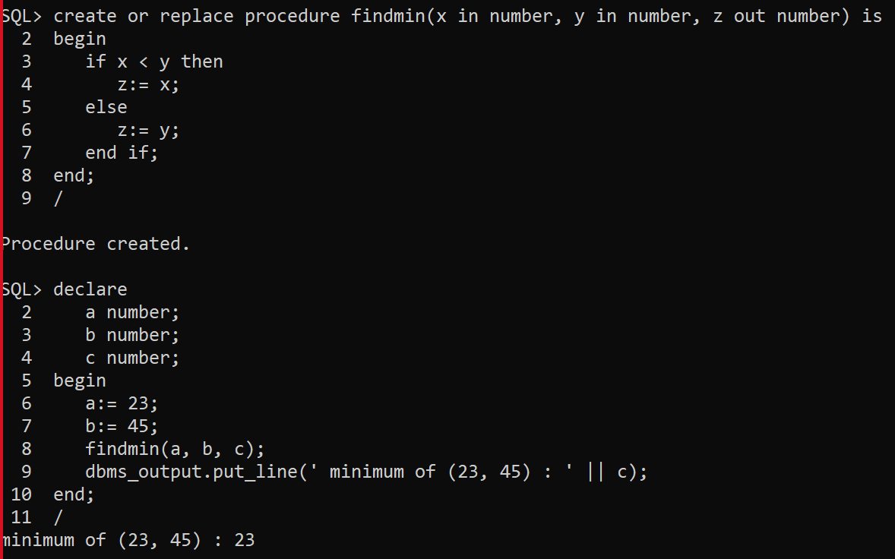

Slide 44
IN & OUT Mode Example 2
declare
a number;
procedure squarenum(x in out number) is
begin
x := x * x;
end;
begin
a:= 23;
squarenum(a);
dbms_output.put_line(' square of (23): ' || a);
end;
/

Slide 45
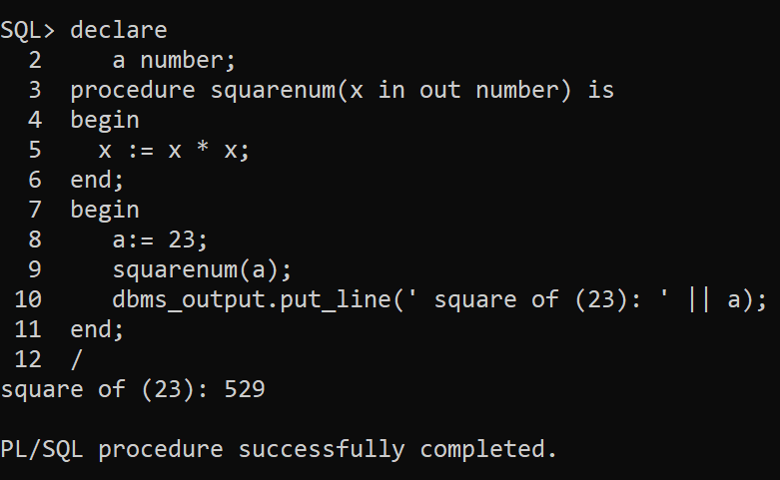
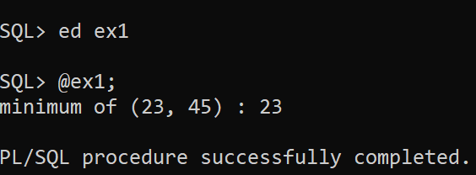

Slide 46
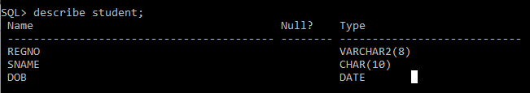
Procedure accessing Tables

Slide 47
Procedure – student table
create or replace procedure pro_insert(x1 varchar,x2 char,x3 date) as
sturegno varchar(8);
stuname char(10);
dob date;
Begin
sturegno:=x1;
stuname:=x2;
dob:=x3;
insert into student values(sturegno, stuname, dob);
dbms_output.put_line('Record Inserted');
end;
/

Slide 48
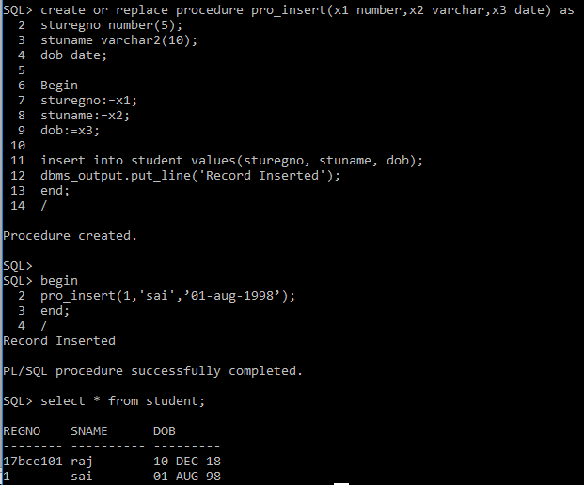

Slide 49
Inventory Table
procode
proname
pqty
pprice

Slide 50
Insert Procedure
SQL> ed ex1;
create or replace procedure pro_insert(x1 varchar,x2 varchar,x3 number,x4 number) as
procode varchar2(5);
proname varchar2(10);
pqty number(4);
pprice number(5);
Begin
procode:=x1;
proname:=x2;
pqty:=x3;
pprice:=x4;
insert into inventory values(procode,proname,pqty,pprice);
dbms_output.put_line('Record Inserted');
end;
/

Slide 51
Compiling and Executing
Execution
  exec procedure-name

Slide 52
Executing Insert Procedure:
SQL> exec pro_insert('p1','book',50,10);
Record Inserted
PL/SQL procedure successfully completed.
SQL> exec pro_insert('p2','pen',60,20);
Record Inserted
PL/SQL procedure successfully completed.
SQL> exec pro_insert('p3','pencil',30,50);
Record Inserted
PL/SQL procedure successfully completed.

Slide 53
Executing Insert Procedure:
SQL> exec pro_insert('p4','ink',10,10);
Record Inserted
PL/SQL procedure successfully completed.
SQL> exec pro_insert('p5','scale',20,5);
Record Inserted
PL/SQL procedure successfully completed.

Slide 54
Executing Insert Procedure:
SQL> select * from inventory;
PCODE PNAME PQTY PPRICE
----- ---------- ---------- ----------
p1 book 50 10
p2 pen 60 20
p3 pencil 30 50
p4 ink 10 10
p5 scale 20 5

Slide 55
Delete Procedure:
SQL> ed ex2;
create or replace procedure pro_del(x1 varchar) as
procode varchar2(5);
begin
procode:=x1;
delete from inventory where pcode=procode;
dbms_output.put_line('Record Deleted');
end;

Slide 56
Executing Delete Procedure:
SQL> exec pro_del('p5');
Record Deleted
PL/SQL procedure successfully completed.
SQL> select * from inventory;
PCODE PNAME PQTY PPRICE
----- ---------- ---------- ----------
p1 book 50 10
p2 pen 60 20
p3 pencil 30 50
p4 ink 10 10

Slide 57
Update Procedure:
SQL> ed ex3;
create or replace procedure pro_update(x1 varchar,x2 number) as
tpcode varchar2(5);
tqty number(4);
tpqty number(10);
Begin
tpcode:=x1;
tqty:=x2;
select tqty into tpqty from inventory where pcode=tpcode;
if SQL%FOUND then
update inventory set pqty=tpqty where pcode=tpcode;
dbms_output.put_line('Record Updated');
else
dbms_output.put_line('No Record Found');
end if;
end;

Slide 58
Update Procedure:
Executing Update Procedure:
SQL> exec pro_update('p4',50);
Record Updated
PL/SQL procedure successfully completed.
SQL> select * from inventory;
PCODE PNAME PQTY PPRICE
----- ---------- ---------- ----------
p1 book 50 10
p2 pen 60 20
p3 pencil 30 50
p4 ink 50 10

Slide 59
Creating a Function
CREATE [OR REPLACE] FUNCTION function_name
[(parameter_name [IN | OUT | IN OUT] type [, ...])]
RETURN return_datatype
{IS | AS}
BEGIN
< function_body >
END [function_name];

Slide 60
Creating a Function
Where,
function-name specifies the name of the function.
[OR REPLACE] option allows modifying an existing function.
The optional parameter list contains name, mode and types of the parameters. IN represents that value will be passed from outside and OUT represents that this parameter will be used to return a value outside of the procedure.
The function must contain a return statement.
RETURN clause specifies that data type you are going to return from the function.
function-body contains the executable part.
The AS keyword is used instead of the IS keyword for creating a standalone function.

Slide 61
Basic function
create or replace function call(x in number) return number is
begin
return x;
end;
/
declare
a number;
x number;
begin
x:=2;
a:=call(x);
dbms_output.put_line('value: '||a);
end;
/

Slide 62
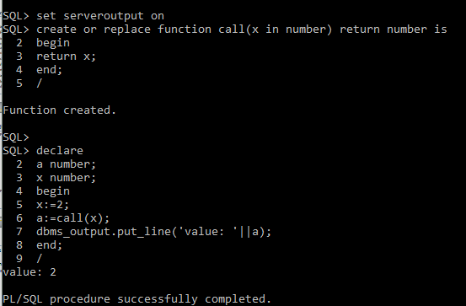
Output
value: 2
Statement processed.
0.01 seconds

Slide 63
DECLARE
a number;
b number;
c number;
function findmax(x in number, y in number)
return number
is
z number;
begin
if x > y then
z:= x;
else
z:= y;
end if;
return z;
end;
BEGIN
a:= 23;
b:= 45;
c := findMax(a, b);
dbms_output.put_line(' Maximum of (23,45): ' || c);
END;
/

Slide 64
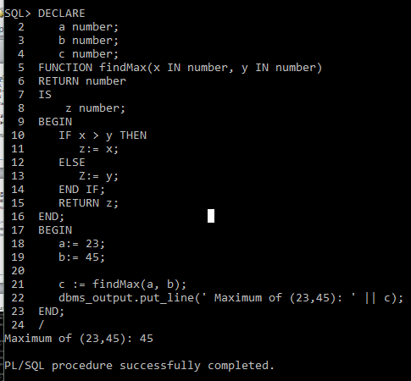
Output

Slide 65
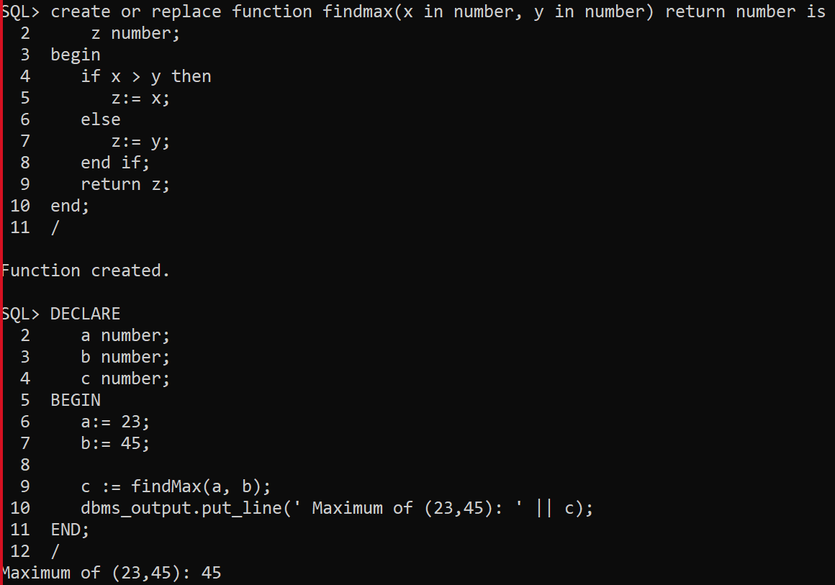

Slide 66
Example:
Select * from customer;
+----+----------+-----+-----------+----------+
| ID | NAME | AGE | ADDRESS | SALARY |
+----+----------+-----+-----------+----------+
| 1 | Ramesh | 32 | Ahmedabad | 2000.00 |
| 2 | Khilan | 25 | Delhi | 1500.00 |
| 3 | kaushik | 23 | Kota | 2000.00 |
| 4 | Chaitali | 25 | Mumbai | 6500.00 |
| 5 | Hardik | 27 | Bhopal | 8500.00 |
| 6 | Komal | 22 | MP | 4500.00 |
+----+----------+-----+-----------+----------+

Slide 67
Function accessing tables
create or replace function totalcustomers
return number is
total number(2) := 0;
begin
select count(*) into total
from customer;
return total;
end;
/

Slide 68
Calling a Function
declare
c number(2);
begin
c := totalcustomers();
dbms_output.put_line('total no. of customers: ' || c);
end;
/

Slide 69
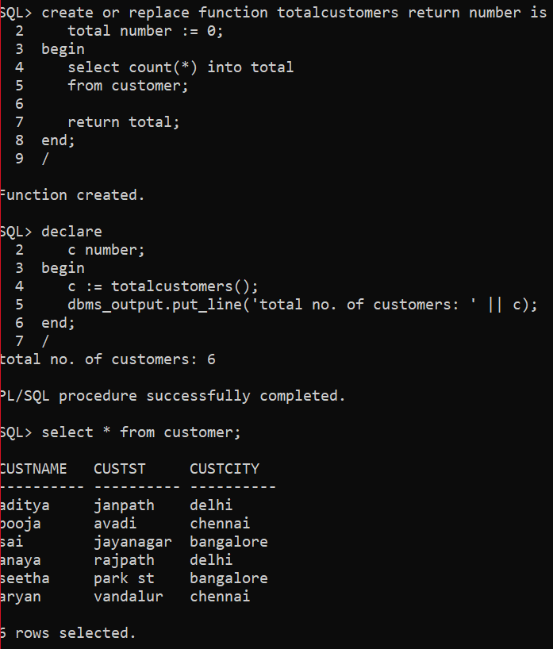
Output

Slide 70
Procedure with Tables
SQL> create or replace procedure totalcity (total out number) is
2 begin
3 select count(distinct custcity) into total
4 from customer;
5 end;
6 /
Procedure created.
SQL> declare
2 c number;
3 begin
4 totalcity(c);
5 dbms_output.put_line('total no. of city: ' || c);
6 end;
7 /
total no. of city: 3
PL/SQL procedure successfully completed.

Slide 71
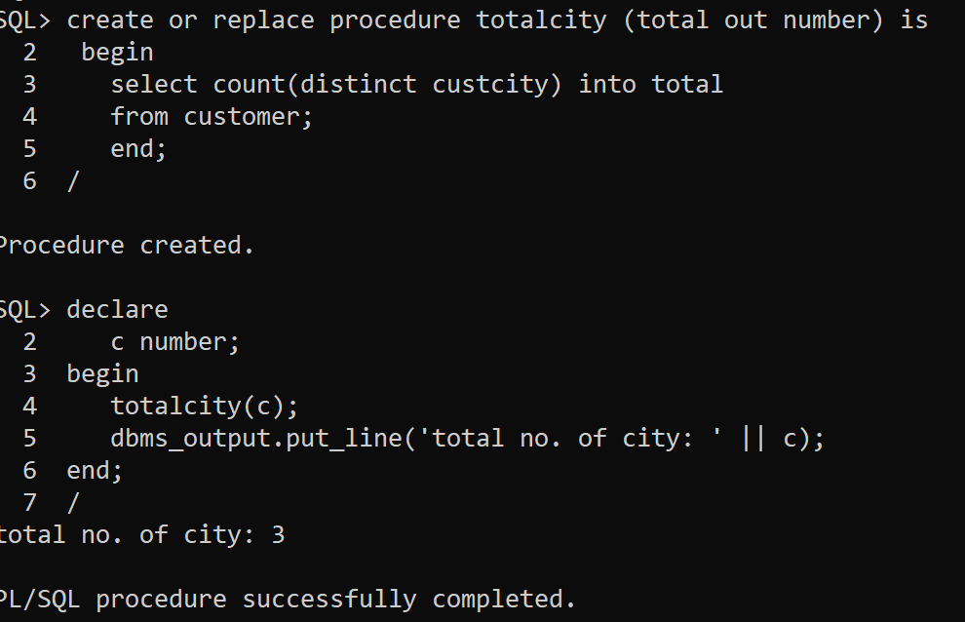
create or replace procedure minmax(min out number, max out number) is
begin
select min(balance) into min, max(balance) into max from account;

